Slide 1
class 1
class 2
class 3
q classifiers to learn

Slide 2
class 1
class 2
class 3
O(q²) classifiers to learn.

Slide 4
⟨β, x⟩ > 0
β
seperating hyperplane
⟨β, x⟩ < 0
⟨β, x⟩ = 0

Slide 6
support vectors
β
β
m
m

Slide 8

β
$$\frac{\text{ε}\text{i}}{\text{∥}\text{β}\text{∥}}$$
1/∥β∥

Slide 9
β
support vectors
$$\frac{\text{ε}\text{i}}{\text{∥}\text{β}\text{∥}}$$
1/∥β∥

Slide 11

support vectors
$$\frac{\text{ε}\text{i}}{\text{∥}\text{β}\text{∥}}$$
large C
smaller C

Slide 12


Slide 13
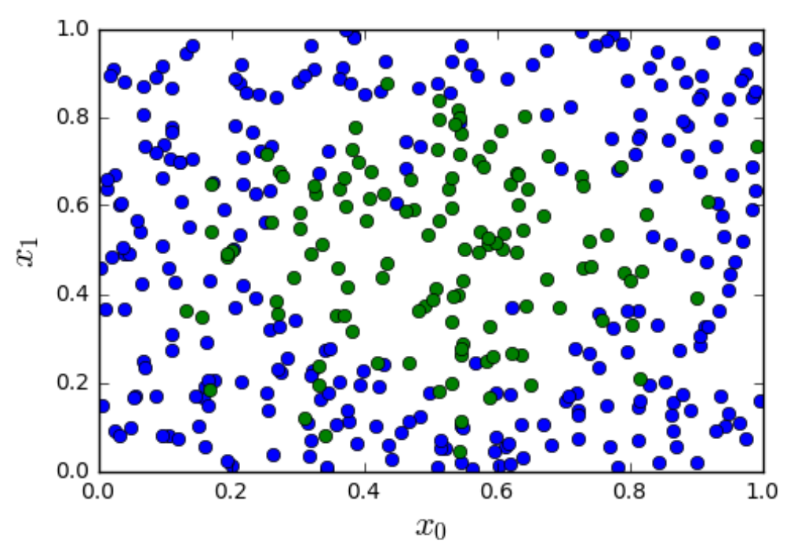
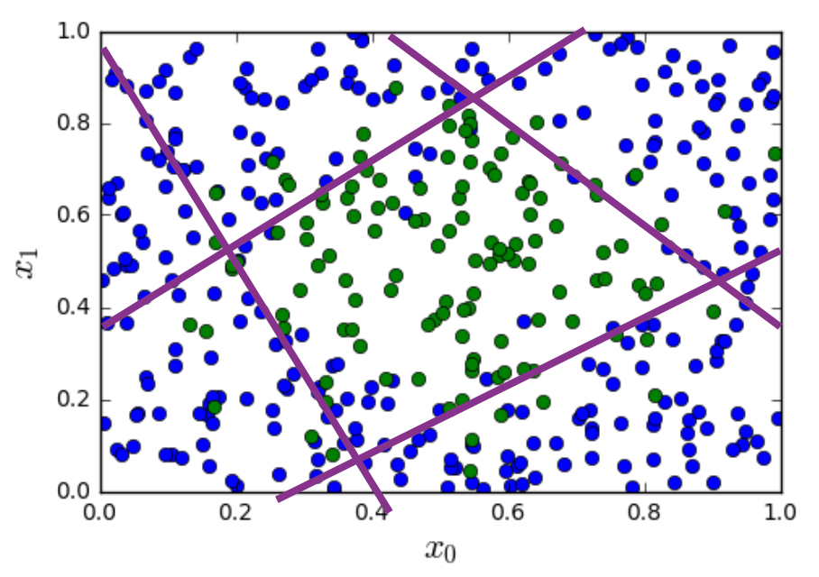

Slide 14
≈ç
0
1
1
0
0
0
1
1

Slide 15
⟹
⟹

Slide 16
non-linearity/
activation function
linear map
non-linearity/
activation function
x₁
linear map
x₂
⟶
z_{O}
⟶
u_{O}
x₃
W_{O}u_{H}+ b_{O}
g(z_{O})
⟶
x
⟶
⟶
⟶
⟶
W_{H}x + b_{H}
z_{H}
⟶
u_{H}
g(z_{H})
output layer
hidden layer

Slide 17
sigmoid
non-linearity
linear map
sigmoid
non-linearity
x₁
linear map
x₂
⟶
z_{O}
⟶
u_{O}
x₃
W_{O}u_{H}+ b_{O}
g(z_{O})
⟶
x
⟶
⟶
⟶
⟶
W_{H}x + b_{H}
z_{H}
⟶
u_{H}
g(z_{H})
output layer
hidden layer

Slide 19
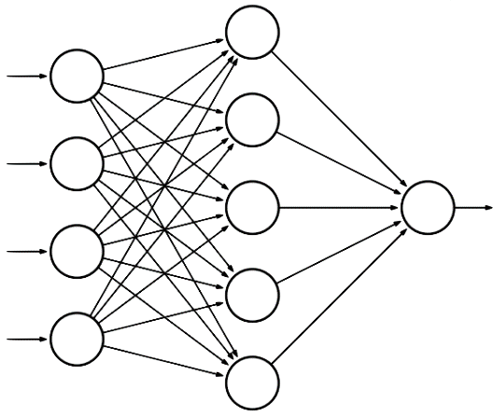
hidden layer
input layer
x₁
output layer
x₂
u_{O}
x₃
z_{O}
x₄
⟶
x
⟶
z_{H}

Slide 20
hidden layer
input layer
W_{H}[1,1]
x₁
W_{H}[1,2]
W_{O}[1,1]
output layer
x₂
W_{H}[1,3]
W_{O}[1,2]
W_{O}[1,3]
u_{O}
x₃
W_{O}[1,4]
z_{O}
W_{H}[1,4]
x₄
W_{O}[1,5]
⟶
x
⟶
z_{H}

Slide 21
hidden layer
input layer
x₁
W_{H}[2,1]
W_{O}[1,1]
W_{H}[2,2]
output layer
x₂
W_{O}[1,2]
W_{H}[2,3]
W_{O}[1,3]
u_{O}
x₃
W_{O}[1,4]
z_{O}
W_{H}[2,4]
x₄
W_{O}[1,5]
⟶
x
⟶
z_{H}

Slide 22
a
x
f = ax + by + cz
y
b
f
c
z
n₁
fire
n₂
∑
no fire
n₃

